Slide 1

React Forms with Yup Integration
Abhishek R Bhat

Slide 2
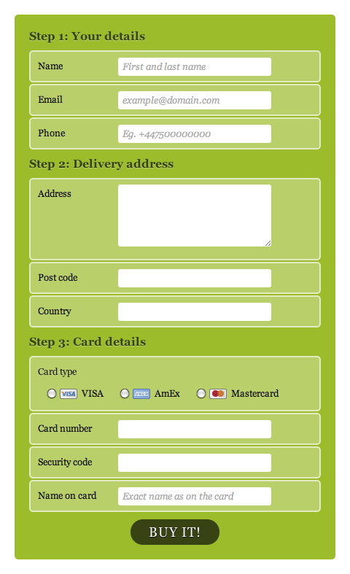
What is Basic Forms in HTML?
A basic form in HTML is a way to collect user input on a web page.
It allows users to enter data that can be sent to a server for processing.

Slide 3
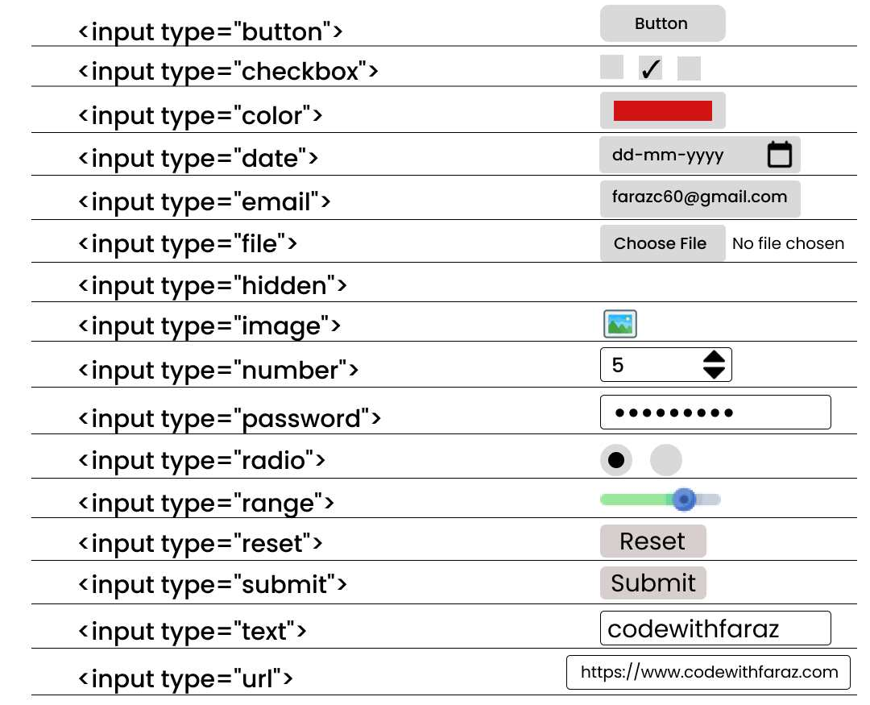
Common HTML Input Types

Slide 4
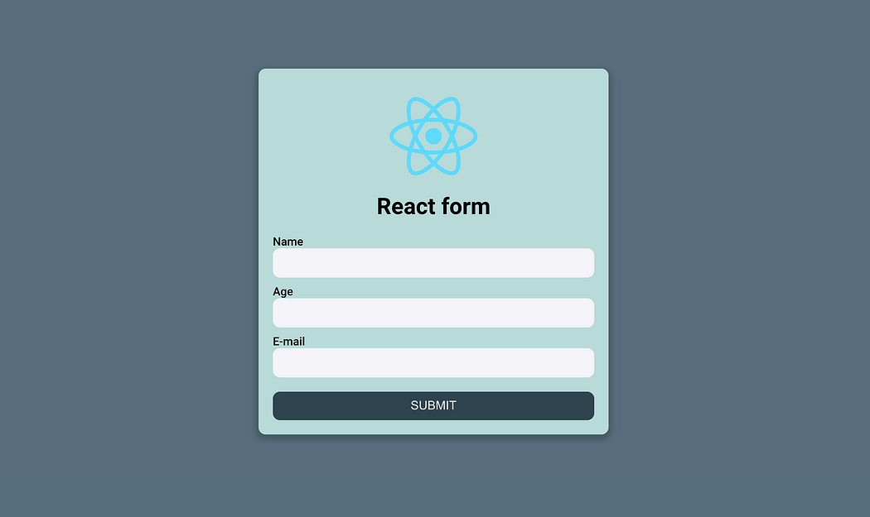

Slide 5

React Forms with Yup Integration
React Forms with Yup integration is a powerful combination for creating robust and well-validated forms in React applications.
Yup is a JavaScript schema validation library that works particularly well with React.
When integrated properly, Yup can provide real-time validation as the user types, improving the user experience.

Slide 6
Advantages of Yup with React Forms
Type Safety: Yup provides strong type checking, which can help catch errors early in development.
Extensive Validation Options: Yup offers a wide range of built-in validators, from basic (required, min, max) to complex (regex, custom functions).
Reusable Schemas: You can define schemas once and reuse them across your application, promoting consistency and reducing code duplication.
Asynchronous Validation: Yup supports asynchronous validation, allowing you to perform validations that require API calls or other async operations.
Nested Object Validation: It's easy to validate complex, nested data structures with Yup.
Custom Error Messages: Yup allows you to define custom error messages for each validation rule, enhancing user experience.

